Slide 1
Instacart Market Basket Analysis
Data Visualization with Power BI
Project submitted by: Group 3
Ankita Ojha
Anna Zhu
Deepika Mantri
Notes:
Instacart is an American company that operates as a sometimes-same-day grocery delivery service.
Customers select groceries mainly order through a mobile phone apps on android or ios. Option of various retailers including Costco, QFC, Fred Meyer etc.
Initially Instacart shoppers simply went to a store and purchased the ordered items at retail as requested, in addition to the delivery charge. and the order is delivered by a personal shoppers on the same-day most of the time.
We need to predict the products that will be re-ordered.

Slide 2

Company Introduction
Instacart is an American company that operates as a sometimes-same-day grocery delivery service.
Customers select groceries mainly through a mobile phone apps on android or ios devices. Option of various retailers are available e.g. including Costco, QFC, Fred Meyer etc.
Instacart shoppers simply went to a store and purchased the ordered items at retails as requested by the customers, in addition to the delivery charge.
Notes:
Est. 2012

Slide 3
Ideation/Questions
Instacart released a public dataset in 2017 for the machine learning community to test models for predicting user purchases. We use PowerBI to create visuals that explore interesting findings emerging from this online grocery shopping data.
What are the popular times to shop?
What is the most ordered product?
What products are more likely to be reordered?
How many products on an average do users order?
Notes:
The goal of analyze this dataset is to predict which products will be in a user's next order?

Slide 4
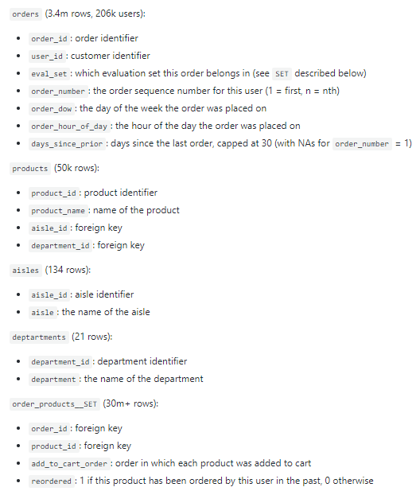
Dataset
The Instacart Online Grocery Shopping Dataset 2017 (Source)
Over 3M grocery orders from more than 200k Instacart users
Data is anonymized
Randomized IDs
No Retailer/Region data
No Customer/ Shopper details
No Order dates or Pricing details
Generic names for Products
Notes:
This anonymized dataset contains a sample of over 3 million grocery orders from more than 200,000 Instacart users.
the data is entirely anonymous:
The only information provided about users is their sequence of orders and the products in those orders
All of the IDs in the dataset are entirely randomized, and cannot be linked back to any other ID
Only products that are bought by multiple people at multiple retailers are included, and no retailer ID is provided
Note that this dataset includes orders from many different retailers and is a heavily biased subset of Instacart’s production data, and so is not a representative sample of our products, users or their purchasing behavior.

Slide 5
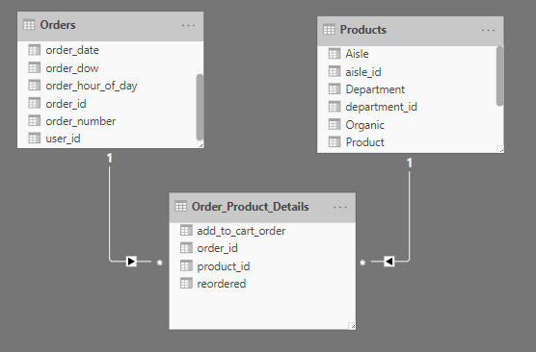
Data Prep and Wrangling
Joined Products table with Aisle and Department table to create a single table
Binded rows of prior and train tables to form a single Order_Products_Details table
New Columns: created with Power BI Query Editor/R
Is Weekend? (conditional column)
Is Organic? (using SEARCH function)
Order_date: <dropped >
Calculated Columns: with DAX
Product_Total: No of times a product was ordered
Reorder_Count: No of times a product was reordered by any user
Reorder_Rate: Reorder _Count / Product_Total

Slide 6
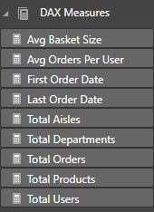
DAX Measures
Avg Basket Size: The average size of the cart.
i.e. the number of products in a cart when the user places an order.
Avg Orders Per User: Average No. of orders made by each user.
Other Generic functions due to lack of Date and Pricing data.

Slide 7
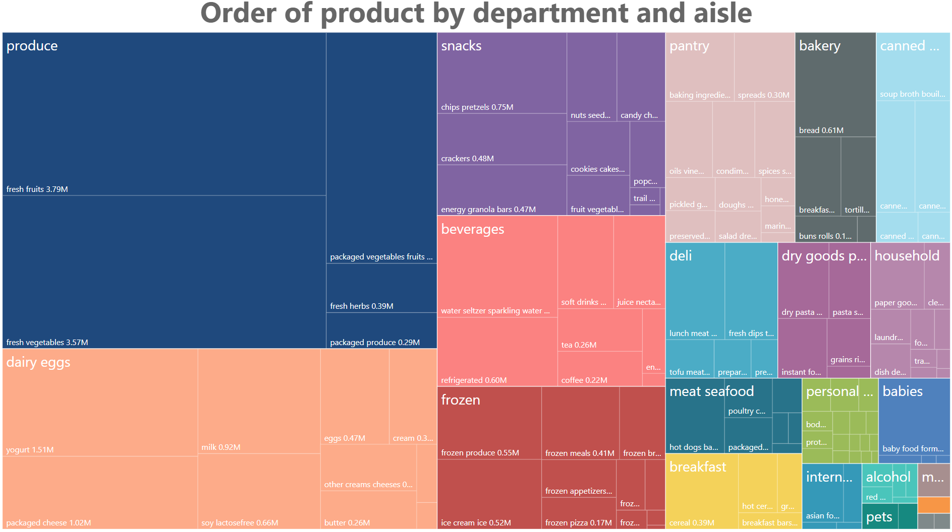
Data Visuals
Notes:
The size of the boxes shows the number of sales.
Here is use to treemap package to visualize the structure of instacarts product portfolio. In total there are 21 departments containing 134 aisles.

Slide 8
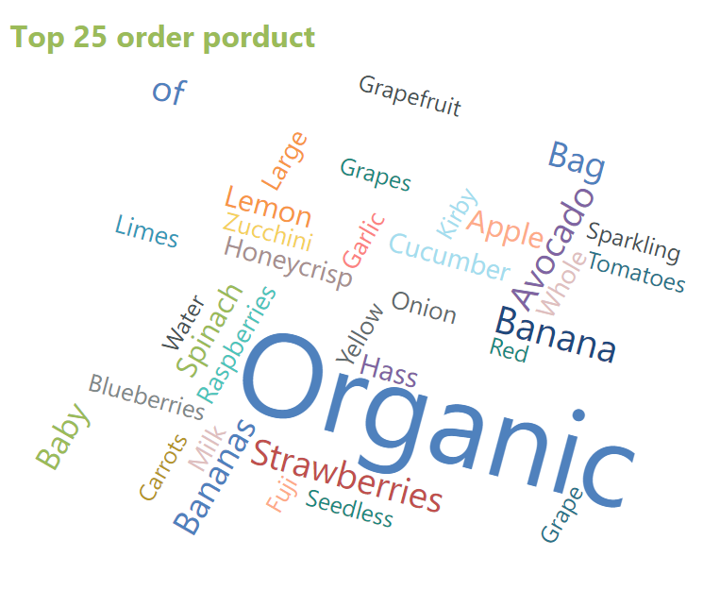
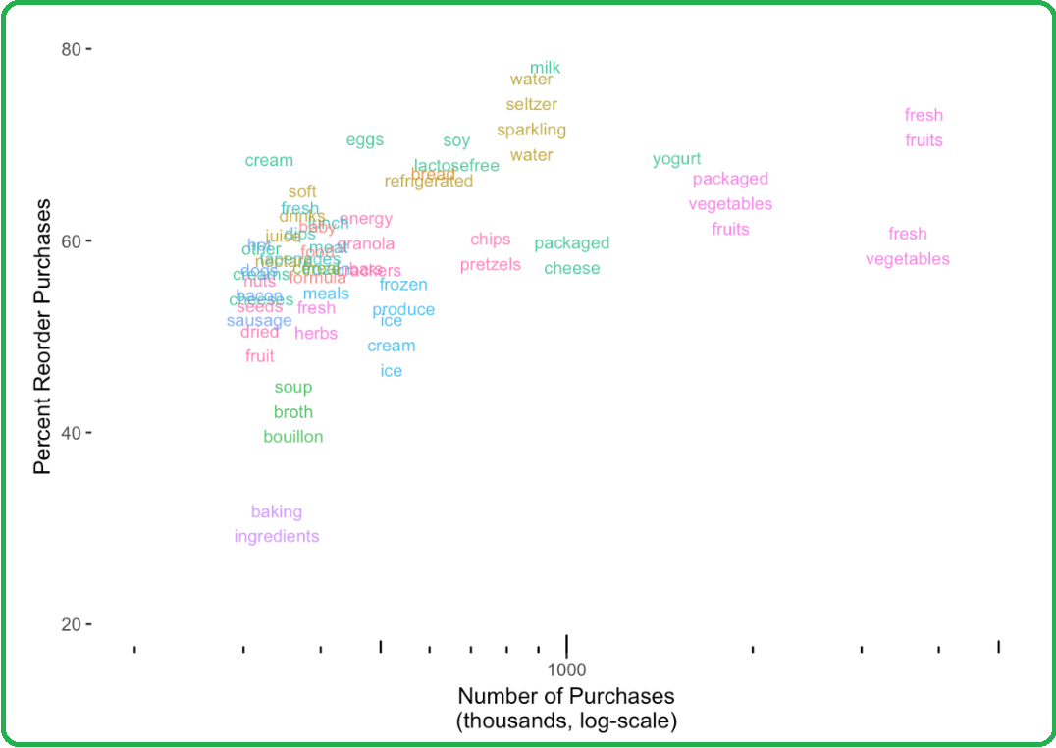
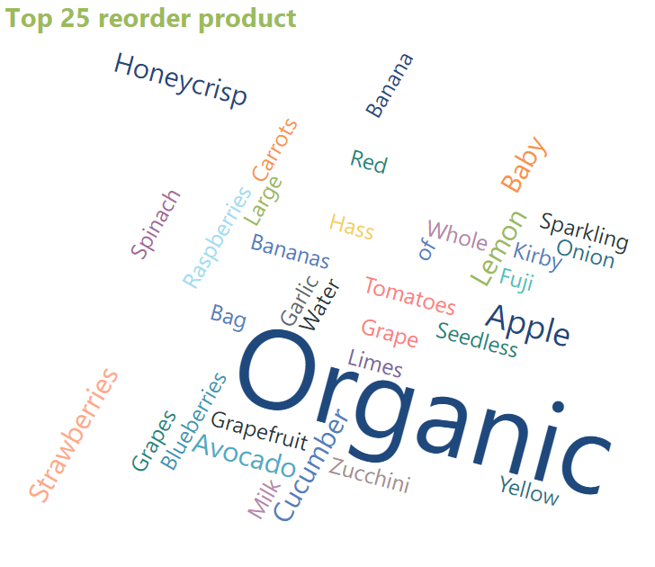
Data Visuals
Stanley, J. (2017) 3 Million Instacart Orders, Open Sourced[png], retrieved from Source
Notes:
------Fruits are reordered more frequently than vegetables — perhaps because vegetables are more intermittently purchased for recipes. Staples like soups and baking ingredients are least likely to be reordered — perhaps because they are less frequently needed.
---------Products with a high number of orders are naturally more likely to be reordered.

Slide 9

Conclusion
What day people order? The Weekend
When do people order? Mostly from 8am to 6pm
How many items do people buy? Avg of 10 items in an order
What products are likely to be reordered? Fresh produce and fruits
Most popular product? Of course , the BANANAAA!
Notes:
This data will also help Instacart in planning their shopper shifts.
Exploring Customer Habits. Churn rate (% of customer who left and Retention rate.)

Slide 10
Thank You!

